Slide 1

BASTA
Biometric Authentication System for Trusted Access
Alessandro Casagrande
Notes:
Biometric data
Encryption for security
Trusted access: ensure integrity of the identity

Slide 2


Summary
1.
2.
3.
4.
5.
6.
7.
8.
Introduction
Image cleaning and enhancement
TCP/IP Client-Server connection
Diffie-Hellman key exchange
Encryption and Watermarking
Transmission over TCP/IP
Decryption and identity check
Future improvements
Notes:
Matlab
Image processing
Client-Server communication
Security steps

Slide 3
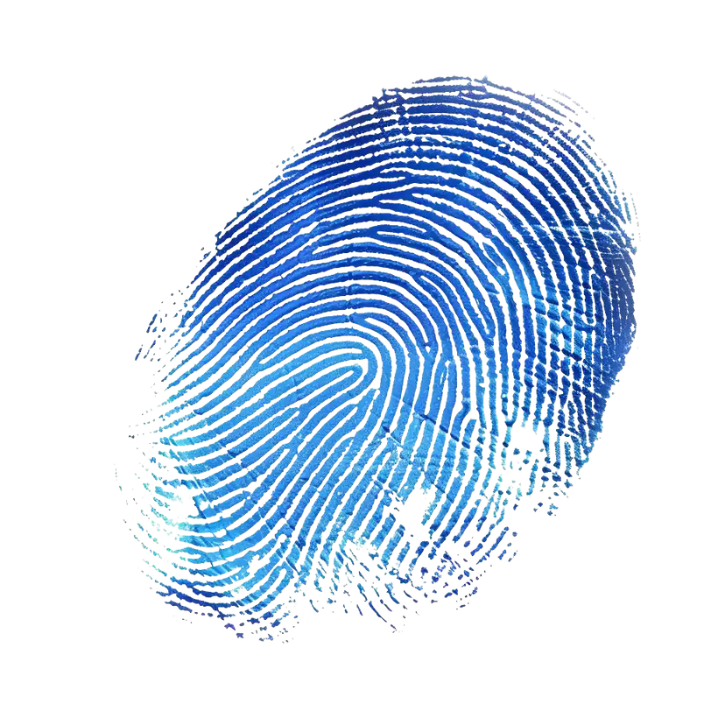


Introduction
Enhanced authentication for biometric systems using commutative watermarking and encryption.
Biometric information: fingerprint
Notes:
Authentication to a certain service using biometric data
Fingerprint
Commutative Encryption and Watermarking

Slide 4
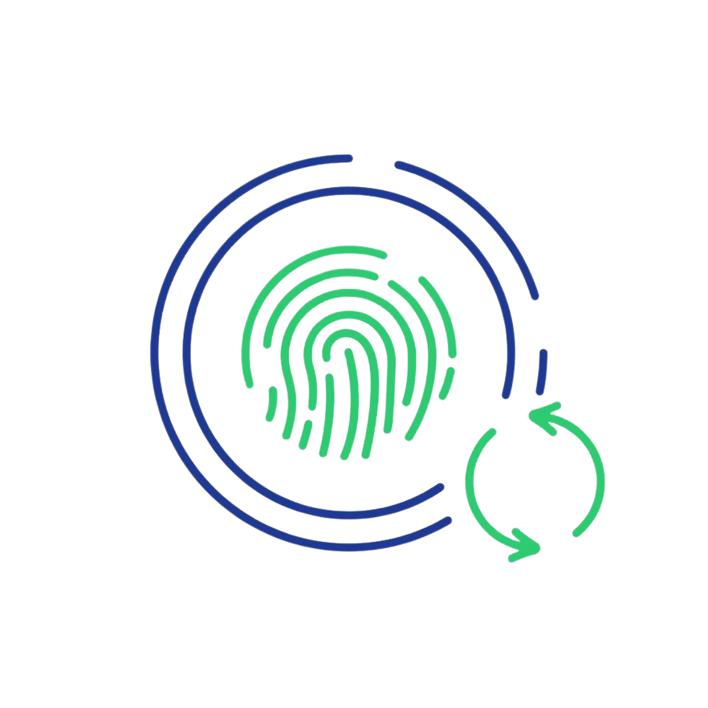

Image cleaning and enhancement
01
Some preprocessing
High-pass Laplacian filter & low-pass Gaussian filter in the Fourier transform domain
02
03
Weighted summation of edges extracted using Canny
Notes:
AIM: increase quality
Preprocessing: remove background
Remove noise
Enhance fine details
Transform domain for efficiency
Again to emphasize contours

Slide 5
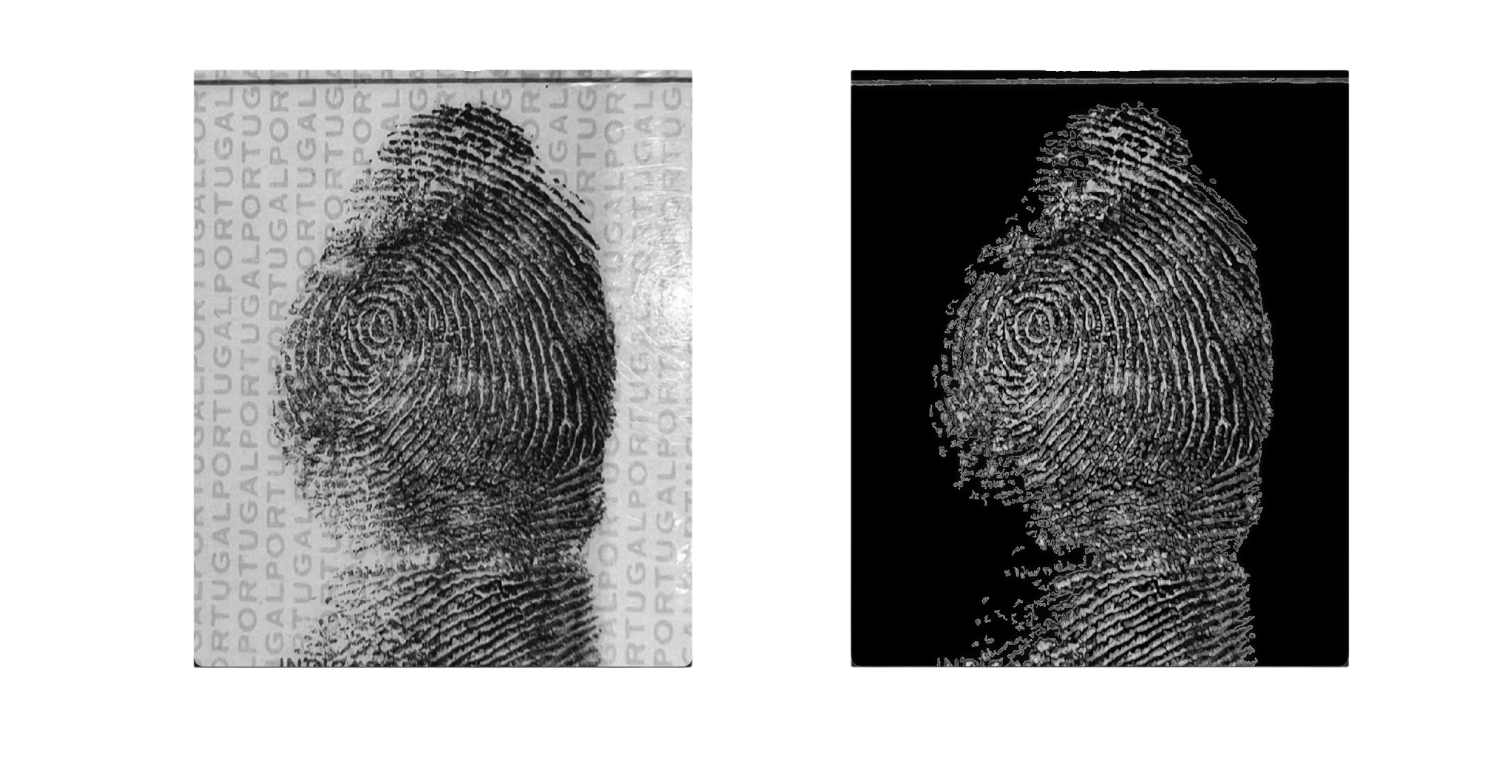
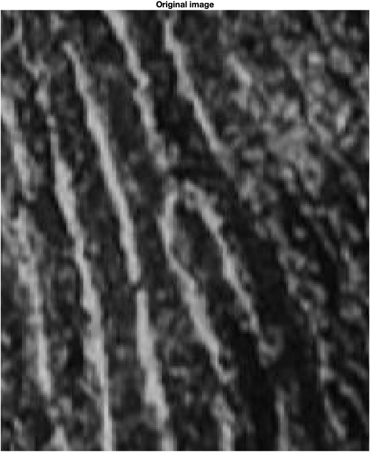
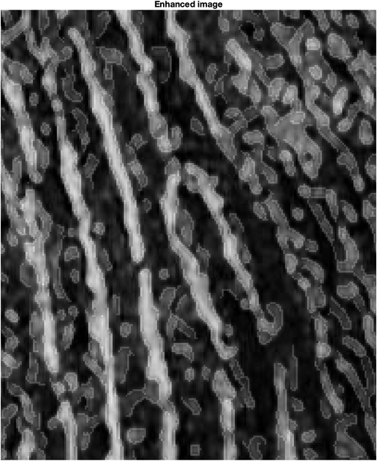

Results
PSNR
51.0889
SSIM
0.95127
Original image
Enhanced image
Notes:
Background
Better in fine details

Slide 6
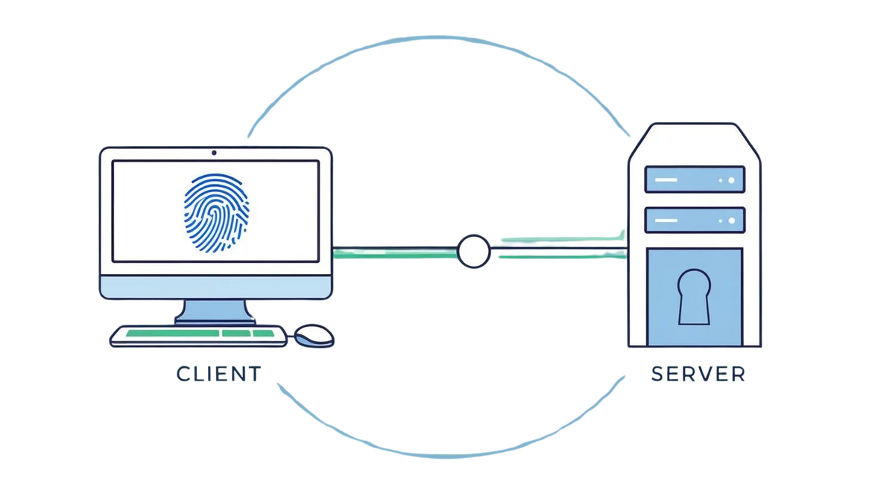
TCP/IP Client-Server connection
Security protocol
Data exchange

Slide 7
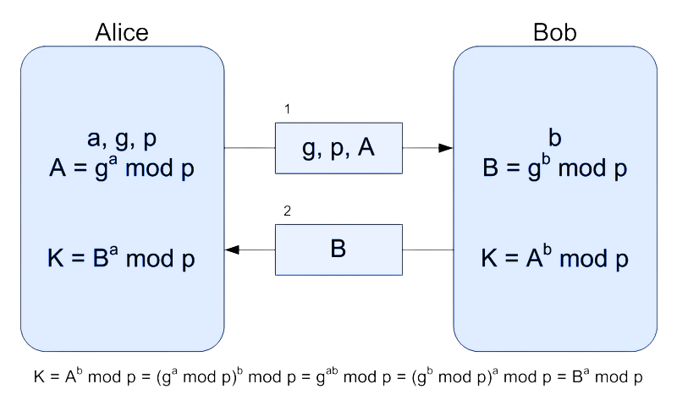
Diffie-Hellman key exchange
Symmetric key exchange using Diffie-Hellman procedure
256 bit key, usage of VPI (Variable Precision Integer) package
Notes:
Without usage of the unsafe channel
They agree on g and p (explain)
VPI specifically designed to handle big numbers

Slide 8
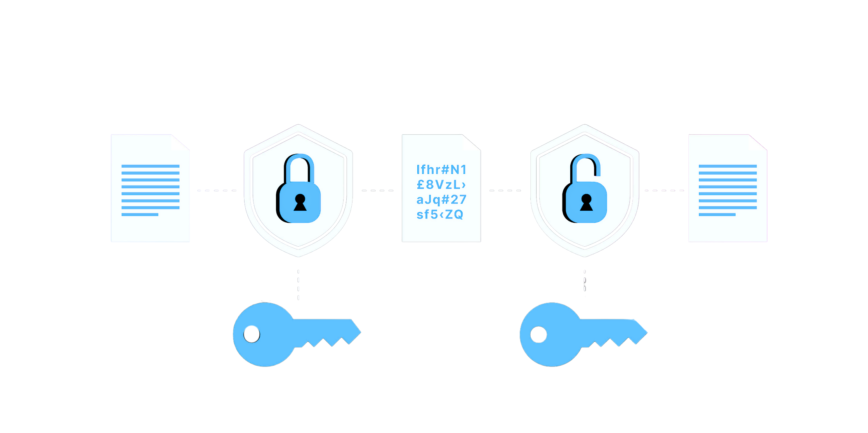
Encryption & Watermarking
Bit plane slicing
The image is sliced into 8 binary bit planes
Encryption
Random shuffle algorithm applied to the first 7 bit planes
Seed derived from the key with SHA-256 hash function
Watermarking
The last bit plane is replaced with a binary watermark
Notes:
Commutative encryption and watermarking
From the key a seed is extracted to initialize the random generator
Random permutation of indexes for each bit plane

Slide 9
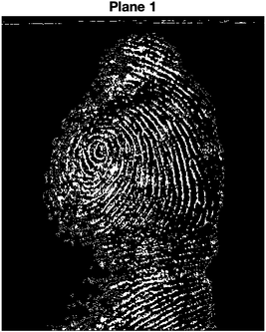
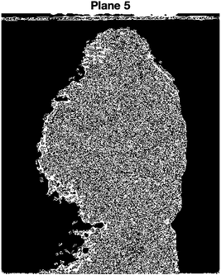
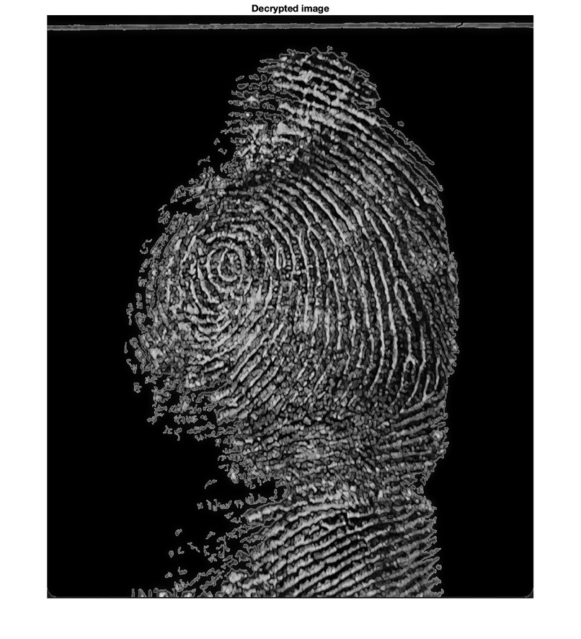
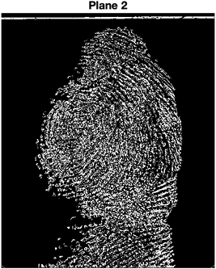
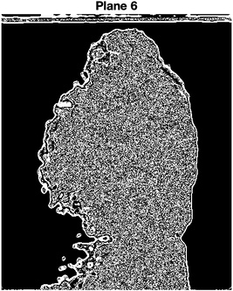

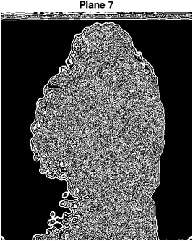
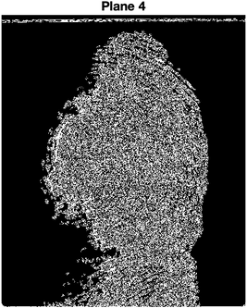
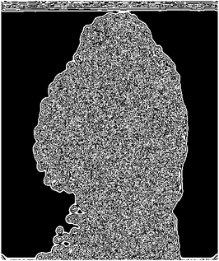
Results
Original Bit Planes
1
5
2
6
3
7
Original image
4
8

Slide 10

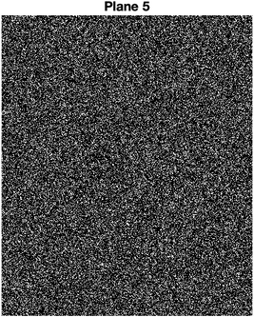

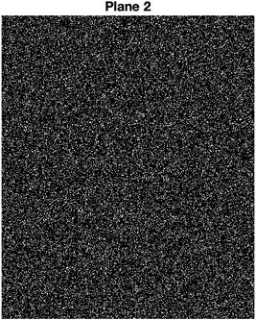
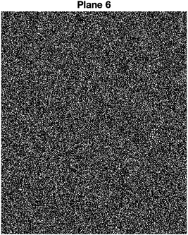
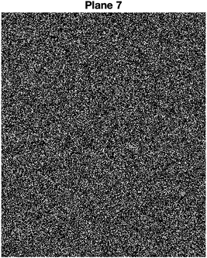
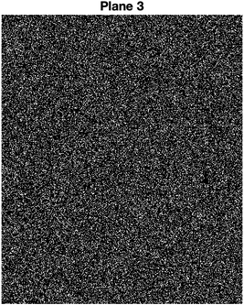
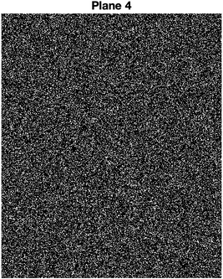
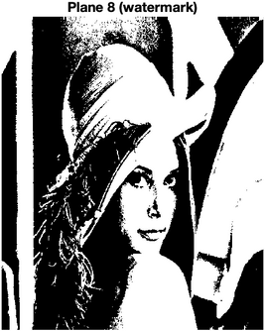
Encrypted Bit Planes
Encrypted and Watermarked image
1
5
2
6
3
7
4
8 (Watermark)

Slide 11




Transmission over TCP/IP
Client
Server
Encrypted to guarantee security
Watermarked to guarantee the user identity
Notes:
Digital signature

Slide 12
Bit plane slicing
Decryption & Watermark check
The image is sliced into 8 binary bit planes
Decryption
Random shuffle algorithm applied to the first 7 bit planes (inverse of client’s one)
Seed derived from the key with SHA-256 hash function (same as client’s one)
Watermark check
The last bit plane should be the expected watermark

Slide 13
Results
Encrypted Bit Planes
1
5
2
6
3
7
Encrypted and Watermarked image
4
8 (Watermark)

Slide 14
Decrypted Bit Planes
Decrypted image
1
5
2
6
3
7
4
8 (Watermark)

Slide 15


Future improvements
More on fingerprint
Minutiae extraction and comparison, to identify the connecting user
Extension to other biometric data
Facial recognition, voice recognition, iris recognition, etc.
Detect and fix security vulnerabilities
Simulation of attacks (brute force, man-in-the-middle, replay, etc.)
Notes:
Security is never the first thing that is considered in a new protocol

Slide 16

References
Reyof-AlQurashi. Image Processing Project — GitHub. 2024. URL: https://github.com/Reyof-AlQurashi/Image_Processing_Project. [Online, last checked: 07.02.2025].
Wikipedia contributors. Diffie–Hellman key exchange — Wikipedia, The Free Encyclopedia. 2025. URL: https://en.wikipedia.org/w/index.php?title=Diffie%E2%80%93Hellman_key_exchange&oldid=1271677942. [Online; last checked 07.02.2025].
John D’Errico. Variable Precision Integer Arithmetic — Matlab Central File Exchange. 2025. URL: https://www.mathworks.com/matlabcentral/fileexchange/22725- variable-precision-integer-arithmetic?status=SUCCESS. [Online, last checked: 07.02.2025]
M. Cancellaro, F. Battisti, M. Carli, G. Boato, F.G.B. De Natale, and A. Neri. “A commutative digital image watermarking and encryption method in the tree structured Haar transform domain”. In: Signal Processing: Image Communication 26.1 (2011), pp. 1–2, 5–6. DOI: https://dx.doi.org/10.1016/j.image.2010.11.001.

